Slide 1

Idea/Approach
Browsers are powerful applications that serve as our gateway to the digital world. However, many of their advanced features remain hidden behind technical barriers, making them inaccessible to everyday users. With the announcement of Gemini Nano in-browser, we saw an opportunity to bridge this gap and unlock the full potential of browsers for users of all ages
Your AI is a sidebar-by-default extension that uses in-browser Gemini Nano to transform Chrome into an intelligent companion. It has an input bar where you can enter what you want to do in natural language using text or your voice.

Slide 2
Technology stack
JavaScript
TypeScript
HTML
React

Slide 3
What it does
It is a sidebar-by-default extension that uses in-browser Gemini Nano to transform Chrome into an intelligent companion with an input bar where you can either use text or your voice to enter what you want to do in natural language. Things you can ask for are:
Smart search
Navigation
Add to Reading List
History Deletion
Tab Recovery
Screenshot
EZ Read Mode
High Contrast
Font Size
Reminders

Slide 4
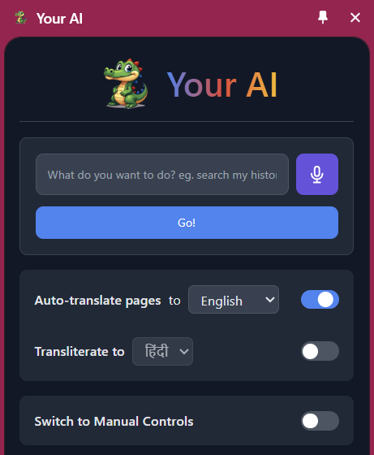
Other Features
Summarization
Croc Writer
Explanation
Translation
Text to speech
Transliteration

Slide 5
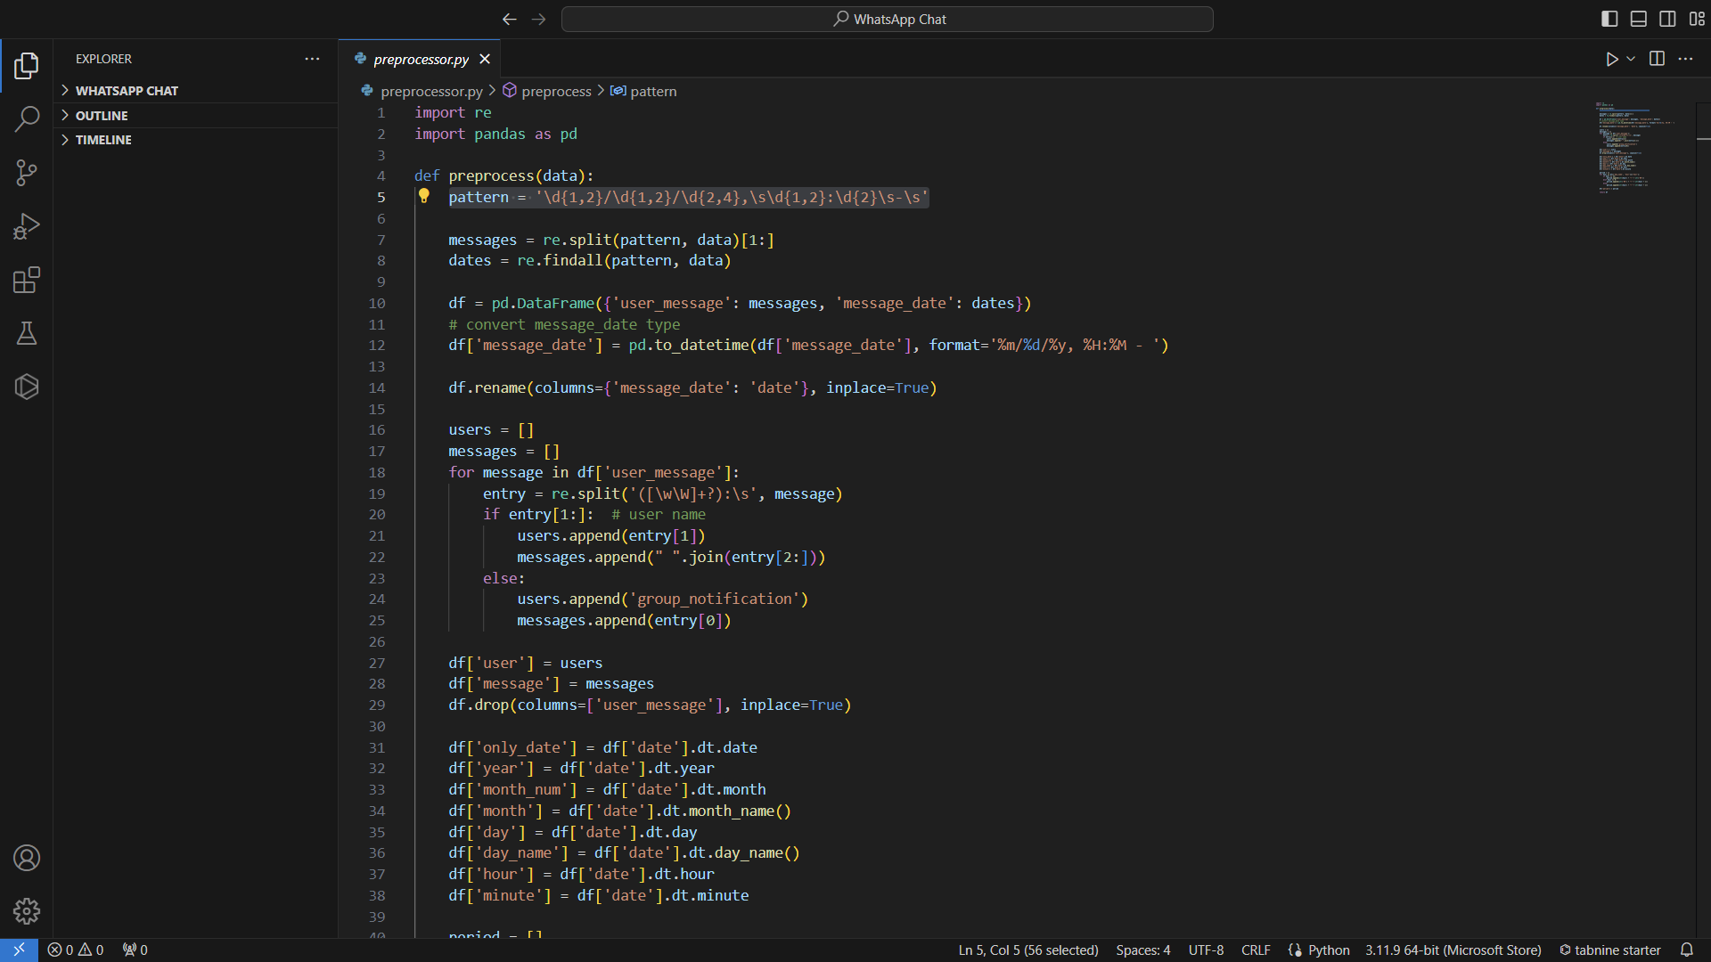
#Preprocessing

Slide 6
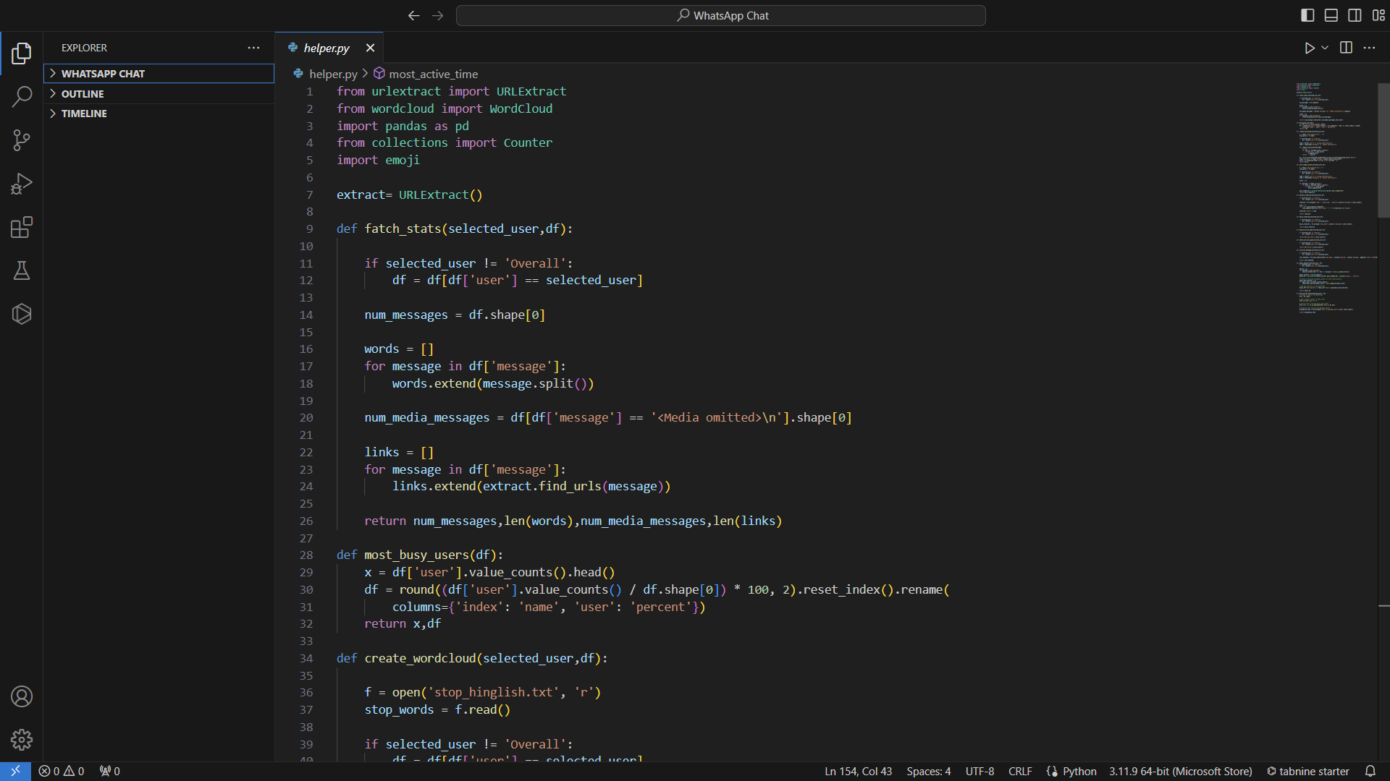
#Helper Code

Slide 7
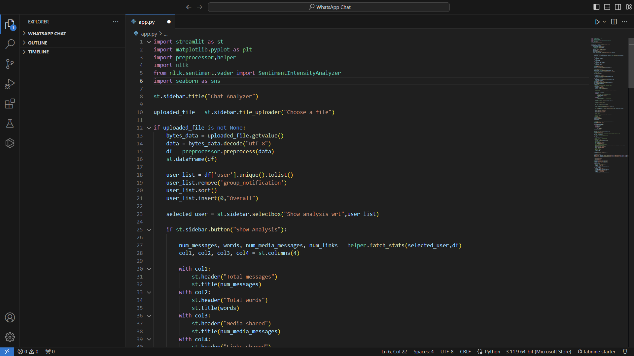
#Main Code

Slide 8
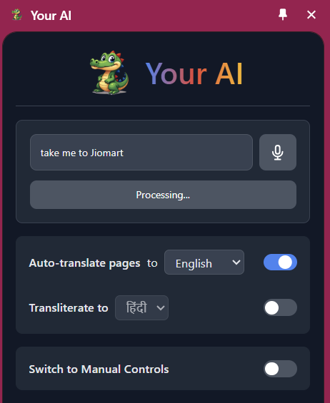
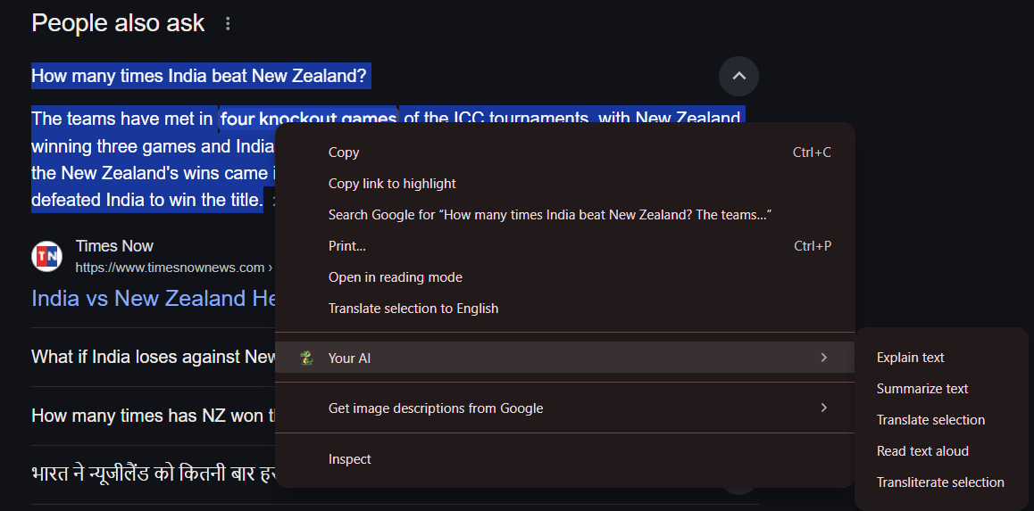
#Snippets

Slide 9
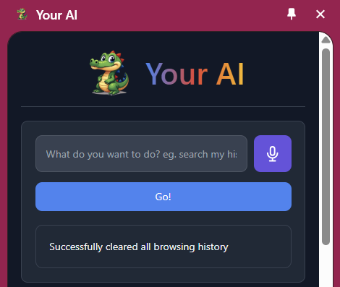
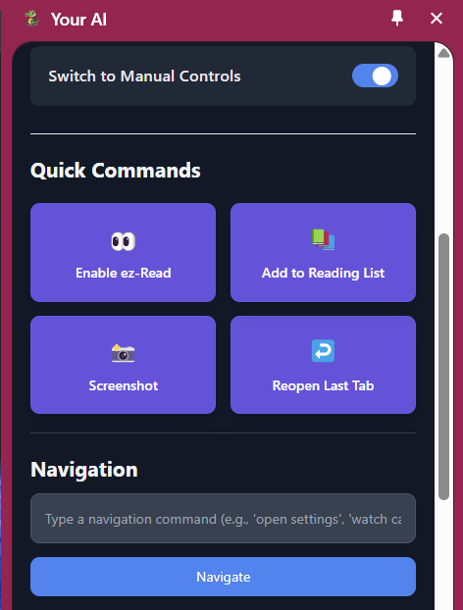
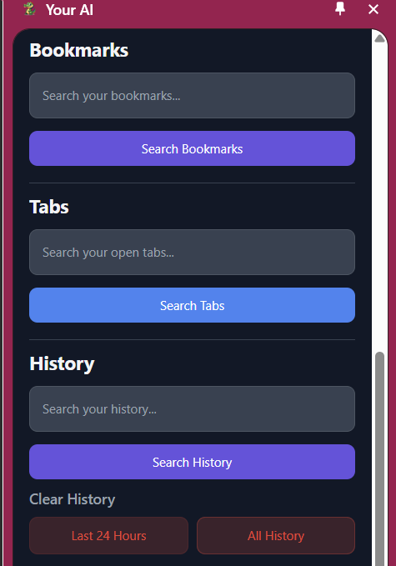

Slide 10

Thank You :)

